Slide 1
Deep Single-View 3D Object Reconstruction with Visual Hull Embedding
Hanqing Wang, Jiaolong Yang, Wei Liang, Xin Tong
Beijing Institute of Technology Microsoft Research Asia
Beijing, China Beijing, China
AAAI 2019
1,2
2
1
2
1
2

Slide 2
Single-View 3D Reconstruction
Input: a single RGB(D) Image
Output: the corresponding 3D representation
Notes:
First let me briefly introduce the single view 3D object reconstruction. Given an image of the object. The goal of 3D object reconstruction is to reconstruct the 3D geometry of the object from the 2D texture. Due to the inherent object ambiguities in certain views, the reconstruction of the unobserved part could be uncertain. Fortunately, with the prior of the 3D geometry of objects, we can partially address the uncertainty basing on the current observation. Therefore, recently people adopt neural network to learn the prior from a big amount of data and predict the 3D shape.

Slide 3
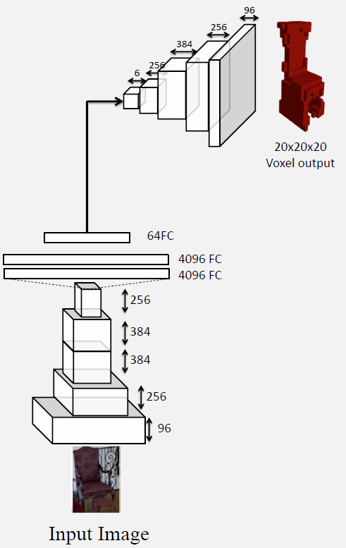
Previous Works
Deep Learning based Methods:
[Choy ECCV’16]
[Girdhar ECCV’16]
Other works:
[Yan NIPS’16][Wu NIPS’16][Tulsiani CVPR’17][Zhu ICCV’17]
Notes:
Most deep 3D reconstruction methods share the similar pipeline. A 2D CNN encodes the input image into a feature vector and then a 3D CNN decodes the feature vector into a 3D volumetric or a point set. But, the methods still have some problems.

Slide 4
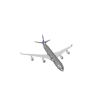
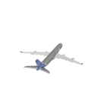
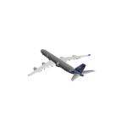
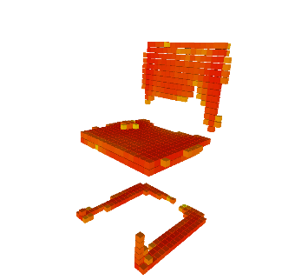
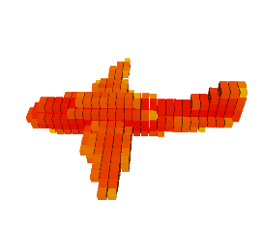
Limitations of previous works
Problems of Existing Deep Learning based Methods:
1. Arbitrary-view images vs. Canonical-view aligned 3D shapes
2. Unsatisfactory results
Y
Z
X
Missing shape details
Inconsistency with input
Notes:
The first problem, in many previous works, the input image can be taken from arbitrary-views while the ground truth locates in a canonical-view aligned coordinate system. The pose transformation is learnt implicitly by the neural network which causes intractable error. The second problem, the predicted results are unsatisfactory. The predicted shapes of neural network may miss details. The plausible shapes are inconsistent with the input images. Our approach tries to address those problems.

Slide 5
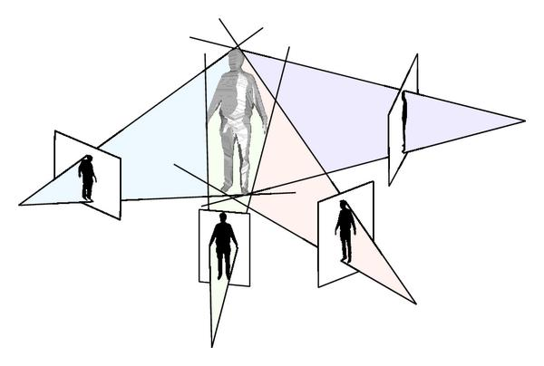
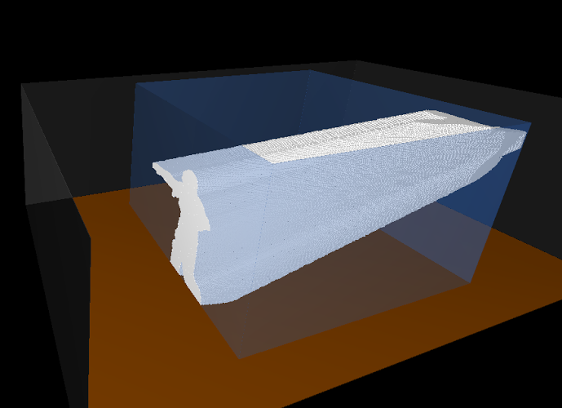
Core Idea
Goal: Reconstruct the object precisely with the given image
Idea: Embed explicitly the 3D-2D projection geometry into a network
Approach: Estimating a single-view visual hull inside of the network
Multi-view Visual Hull
Single-view Visual Hull
Notes:
Our core idea is inspired by the conventional 3D stereo. We hope to keep the 3D projection of the reconstruction consistent with the 2D input. We achieve this goal by estimate a single-view visual hull inside of the network to constrain the consistency between 3D projection and 2D input.

Slide 6
Method Overview
CNN
Coarse Shape
CNN
CNN
Final Shape
Input Image
Silhouette
CNN
Single-View Visual Hull
Pose
Notes:
Here is the overview of our approach. Given an input image, (click) we first predict the coarse shape, which is represented as discrete 3D volumetric, the 2D silhouette and the pose of the object by three CNNs.
(click) With the pose parameters, we can inversely-project the silhouette into a single-view visual hull by our PSVH layer.
(click) Finally, we feed the visual hull and the coarse shape into the refinement network to get the refined 3D shape.

Slide 7
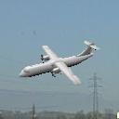
Components
(R,T)
(R,T)
CNN
2D Encoder
2D Encoder
2D Decoder
3D Decoder
2D Decoder
2D Encoder
3D Decoder
2D Encoder
Regressor
Regressor
Coarse Shape
CNN
+
+
3D Decoder
3D Encoder
3D Decoder
CNN
3D Encoder
Final Shape
V-Net: coarse shape prediction
P-Net: object pose and camera parameters estimation
S-Net: silhouette prediction
PSVH layer: visual hull generation
R-Net: coarse shape refinement
V-Net: coarse shape prediction
P-Net: object pose and camera parameters estimation
S-Net: silhouette prediction
PSVH layer: visual hull generation
R-Net: coarse shape refinement
Input Image
Silhouette
CNN
Single-View Visual Hull
Pose
Notes:
Here are the components of our approach.

Slide 8
Components
(R,T)
(R,T)
2D Encoder
2D Encoder
2D Decoder
3D Decoder
2D Decoder
2D Encoder
3D Decoder
2D Encoder
Regressor
Regressor
+
+
3D Decoder
3D Encoder
3D Decoder
3D Encoder
V-Net: coarse shape prediction
P-Net: object pose and camera parameters estimation
S-Net: silhouette prediction
PSVH layer: visual hull generation
R-Net: coarse shape refinement
V-Net: coarse shape prediction
P-Net: object pose and camera parameters estimation
S-Net: silhouette prediction
PSVH layer: visual hull generation
R-Net: coarse shape refinement
Notes:
The first part is the V-Net that predict the coarse shape by an encoder/decoder CNN. We formulate the reconstruction as the prediction of the occupancy probability distribution in 3D space. More specifically, for each voxel, we predict the probability that the voxel is occupied, ranging from 0 to 1.

Slide 9
Components
(R,T)
(R,T)
2D Encoder
2D Encoder
2D Decoder
3D Decoder
2D Decoder
2D Encoder
3D Decoder
2D Encoder
Regressor
Regressor
+
+
3D Decoder
3D Encoder
3D Decoder
3D Encoder
V-Net: coarse shape prediction
P-Net: object pose and camera parameters estimation
S-Net: silhouette prediction
PSVH layer: visual hull generation
R-Net: coarse shape refinement
V-Net: coarse shape prediction
P-Net: object pose and camera parameters estimation
S-Net: silhouette prediction
PSVH layer: visual hull generation
R-Net: coarse shape refinement
Notes:
The second part is the P-Net that predict the pose of the object and the camera parameters. The pose of the object is represented by three Euler angles. The camera parameters are x/y directional translations in the projection plane and the distance between the camera and the center of the object. We formulate the estimation as a regression problem and estimate the parameters by a network.

Slide 10
Components
(R,T)
(R,T)
2D Encoder
2D Encoder
2D Decoder
3D Decoder
2D Decoder
2D Encoder
3D Decoder
2D Encoder
Regressor
Regressor
+
+
3D Decoder
3D Encoder
3D Decoder
3D Encoder
V-Net: coarse shape prediction
P-Net: object pose and camera parameters estimation
S-Net: silhouette prediction
PSVH layer: visual hull generation
R-Net: coarse shape refinement
V-Net: coarse shape prediction
P-Net: object pose and camera parameters estimation
S-Net: silhouette prediction
PSVH layer: visual hull generation
R-Net: coarse shape refinement
Notes:
The third part is the S-Net that predict the silhouette of the object. We formulate the prediction as a foreground and background segmentation. Similar to the first part, we estimate the probability of the pixel that belongs to the foreground.

Slide 11
Components
(R,T)
(R,T)
2D Encoder
2D Encoder
2D Decoder
3D Decoder
2D Decoder
2D Encoder
3D Decoder
2D Encoder
Regressor
Regressor
+
+
3D Decoder
3D Encoder
3D Decoder
3D Encoder
V-Net: coarse shape prediction
P-Net: object pose and camera parameters estimation
S-Net: silhouette prediction
PSVH layer: visual hull generation
R-Net: coarse shape refinement
V-Net: coarse shape prediction
P-Net: object pose and camera parameters estimation
S-Net: silhouette prediction
PSVH layer: visual hull generation
R-Net: coarse shape refinement
Notes:
The forth part is the PSVH layer that we propose to “inversely-project” the silhouette into the visual hull.
(click) Specifically, with the pose and camera parameters, we calculate the correspondence between the silhouette and the discrete 3D space.
(click) Then we can set the probability of the voxel by the probability of the correspondent silhouette pixel.
(click) Here we visualize the voxels with the probability above 0.4.

Slide 12
Components
(R,T)
(R,T)
2D Encoder
2D Encoder
2D Decoder
3D Decoder
2D Decoder
2D Encoder
3D Decoder
2D Encoder
Regressor
Regressor
+
+
3D Decoder
3D Encoder
3D Decoder
3D Encoder
V-Net: coarse shape prediction
P-Net: object pose and camera parameters estimation
S-Net: silhouette prediction
PSVH layer: visual hull generation
R-Net: coarse shape refinement
V-Net: coarse shape prediction
P-Net: object pose and camera parameters estimation
S-Net: silhouette prediction
PSVH layer: visual hull generation
R-Net: coarse shape refinement
Notes:
The last part is the R-Net that refines the coarse shape denoted as V with the help of visual hull denoted as H. In addition to the coarse shape and the visual hull, we also feed two occupancy probability maps. These two probability maps characterize voxels in V but not in H, and voxels in H but not in V, respectively. we add a residual connection between the input voxel prediction V and the output of the last layer. This way, we guide R-Net to generate an effective shape deformation to refine V rather than directly predicting a new shape.

Slide 13
Notes:
(e) is the R-Net that refines the coarse shape with the help of visual hull. We define the function of the R-Net as a residual of the coarse shape so that the network could concentrate on the work of refinement.

Slide 14
Details of PSVH Layer
The relationship between a 3D point $(X,Y,Z)$ and its projected pixel location $(u,v)$ on the image is
(1)
Where the camera intrinsic matrix , is the rotation
matrix generated by three Euler angles, noted as , is the translation vector. For translation we estimate $t_{Z}$ and a 2D vector $[t_{u}, t_{v}]$ which centralizes the object on image plane, and obtain $t$ via ${\left[\frac{t_{u}}{f}∗t_{Z},\frac{t_{v}}{f}∗t_{Z},t_{Z}\right]}^{T}$.
In summary, we parameterize the pose as a 6-D vector
$$Z{\left[u,v,1\right]}^{T}=K(R{\left[X,Y,Z\right]}^{T}+t)$$
$$K=\left[\begin{matrix}f & 0 & u_{0} \\ 0 & f & v_{0} \\ 0 & 0 & 1\end{matrix}\right]$$
$$R∈SO(3)$$
$$[θ_{1},θ_{2},θ_{3}]$$
$t={\left[t_{X},t_{Y},t_{z}\right]}^{T}∈ℝ^{3}$
$$p={\left[{θ_{1},θ_{2},θ_{3},t}_{u},t_{v},t_{z}\right]}^{T}$$
Notes:
Here we introduce the details of our PSVH layer.
Please refer to our paper for more details.

Slide 15
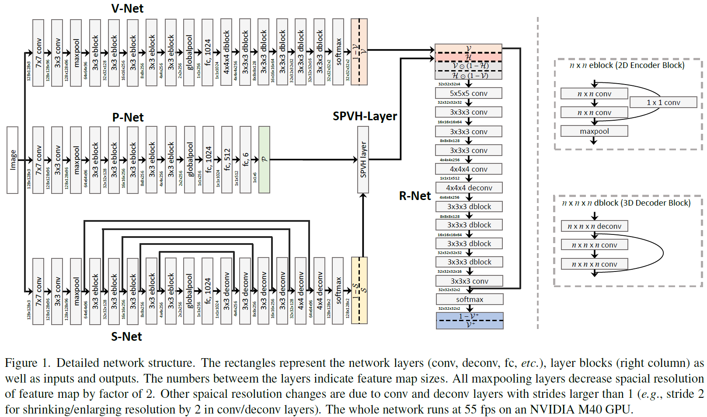
Network Architecture
Overview:
Notes:
Here is the architecture of our network. It’s worth noting that all operations in our network are differentiable. It means that our network can do end-to-end training.

Slide 16
Training Details
Loss:
We use the binary cross-entropy loss to train V-Net, S-Net and R-Net, let $p_{n}$ be the estimated probability at location $n$, the loss is defined as
(2)
Where $p_{n}^{∗}$ is the target probability
For P-Net, we use the $L_{1}$ regression loss to train the network:
(3)
where we set $α=1, γ=1, β=0.01$
$$l=−\frac{1}{N}\sum_{n}{(p_{n}^{∗}\log{p_{n}}+\left(1−p_{n}^{∗}\right)log⁡(1−p_{n}))}$$
$$l=\sum_{i=1,2,3}{α\left|θ_{i}−θ_{i}^{∗}\right|}+\sum_{j=u,v}{β\left|t_{j}−t_{j}^{∗}\right|}+γ\left|t_{Z}−t_{Z}^{∗}\right|$$
Notes:
Now let me introduce the training details. Here is the loss we use in our training. The loss of V-Net (coarse shape), S-Net (silhouette), R-Net (refinement) are similar, using the binary cross entropy. The P-Net(pose) use the L1 regression loss.

Slide 17
Training Details
Steps:
Train the V-Net, S-Net, P-Net independently.
Train the R-Net with the coarse shape predicted by V-Net and the ground truth visual hull.
Train the whole network end-to-end.
Notes:
Here is the training steps of our approach. We first train the V-Net, S-Net, P-Net independently. Then we train the R-Net with the coarse shape predicted by V-Net and the ground truth visual hull. And last, we train the whole network end-to-end. The second step is designed to make the R-Net more easily to learn how to deform the shape and through the last step end-to-end training, we grant the sub-nets more opportunity to cooperate accordingly.

Slide 18
Implementation Details
Network implemented in Tensorflow
Input image size: 128x128x3
Output voxel grid size: 32x32x32

Slide 19
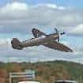
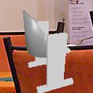
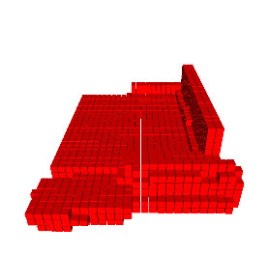
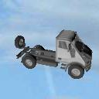
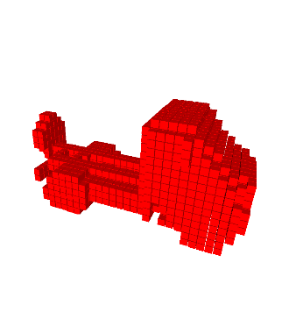
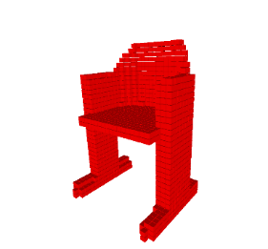
Dataset
Object categories: car, airplane, chair, sofa
Datasets:
Rendered ShapeNet objects – (ShapeNet) dataset of tremendous CAD models
Real images - (PASCAL 3D+ dataset) manually associated with limited CAD models
Notes:
We demonstrated our approach on four object categories. We did experiments on a synthetic dataset that rendered from ShapeNet objects and a real image dataset, the PASCAL 3D+.

Slide 20
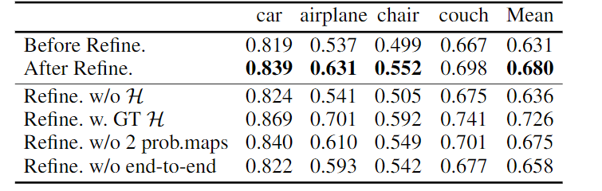
Experiments
Results on the 3D-R2N2 dataset (rendered ShapeNet objects)
Ablation study:
Notes:
We did ablation study on the synthetic dataset. The approaches are evaluated by Intersection over Union(IoU). We use the V-Net as the base line, denoted as “Before Refine” in this table, it is worth noting that our baseline is the single view version of 3D-R2N2 which is a state-of-the-art multi-view 3D reconstruction method. Our whole network is denoted as “After Refine”. It shows that the results after refinement are significantly better.
(click) To verify the effectiveness of the visual hull input, we trained the whole network without the visual-hull input, the IoU is marginally better than the IoU of baseline which means the visual hull is very important. To see the performance limitation of our approach, we also trained the whole network with ground truth visual hull input. The IoU is even much higher than the IoU of “After Refine”.
(click) To verify the effectiveness of the two additional probability maps, we trained the network without the two additional probability map input, we see a big drop on the airplane category, it means that the two probability maps are helpful.
(click) We also evaluate the network that not been trained end-to-end, the IoU of “After Refine” is much better than the IoU of the network without end-to-end training. It illustrates that our end-to-end training is necessary.

Slide 21
Experiments
Results on the rendered ShapeNet objects
Notes:
Here are some results on the synthetic data. While the coarse shapes may miss some shape details or be inconsistent with the image, our final shapes refined with single-view visual hulls are of high fidelity. Our approach preserves some shape details and consistencies.

Slide 22
Experiments
Results on the rendered ShapeNet objects
Notes:
Here are the results of chair and sofa categories.

Slide 23
Experiments
Results on the synthetic dataset (rendered ShapeNet objects)
Ablation study:
Notes:
This result presents the comparisons between the coarse shape and the refined shape, where the object IDs are uniformly sampled and sorted by the IoUs of coarse shapes. The efficacy of our refinement scheme can be clearly seen. It consistently benefits the shape reconstruction for most of the objects, despite none of them is seen before.

Slide 24
Experiments
Comparison with MarrNet[Wu et al. 2017] on the synthetic dataset
Notes:
Result comparison with the MarrNet method on ShapeNet chairs. MarrNet is another state-of-the-art single view 3D reconstruction method. Top two rows are cherry-picked results of MarrNet, compared against our results. Bottom two rows are cherry-picked results of our method, compared against MarrNet results. Our approach preserves more details.

Slide 25
Experiments
Results on the PASCAL 3D+ dataset (real images)
Notes:
Here some qualitative results on real images. The result of a airplane and a car. It can be seen that the coarse shapes of the plane is noisy. But with the hint of visual hull, the refined shape is much better.

Slide 26
Experiments
Results on the PASCAL 3D+ dataset (real images)
IoU 0.716
IoU 0.793
IoU 0.937
Notes:
Here are the results of chair and sofa. Our approach precisely recovers the style of the object in the image.

Slide 27
Running Time
~18ms for one image (55 fps!)
(Tested with a batch of 24 images on a NVIDIA Tesla M40 GPU)
Notes:
Here is the running time of our approach. The inference takes about 18ms for one image. Our network can do very fast inference.

Slide 28
Contributions
Embedding Domain knowledge (3D-2D perspective geometry) into a DNN
Performing reconstruction jointly with segmentation and pose estimation
A novel, GPU-friendly PSVH (Probabilistic Single-view Visual Hull) layer
Notes:
Here we summary our contributions. We propose a novel 3D reconstruction neural network structure. We embed the domain knowledge into a Deep Neural Network. Performing reconstruction jointly with segmentation and pose estimation. We propose a novel, GPU-friendly probabilistic single-view visual hull layer.

Slide 29
Thanks for listening!
Welcome to ask any problem!
Email: hanqingwang@bit.edu.cn

